Slide 1

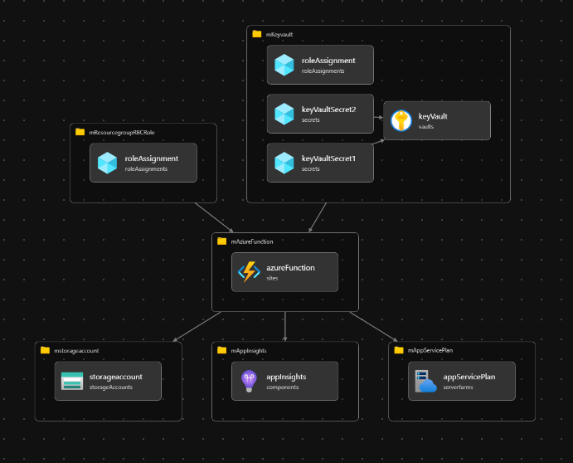
Azure IAC
LV
Lerevit
Complete Guideline to BICEP

Slide 2
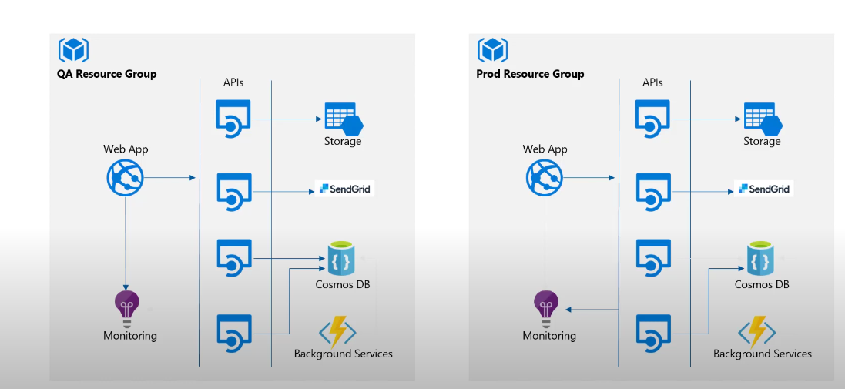
What is Azure Infra…

Slide 3
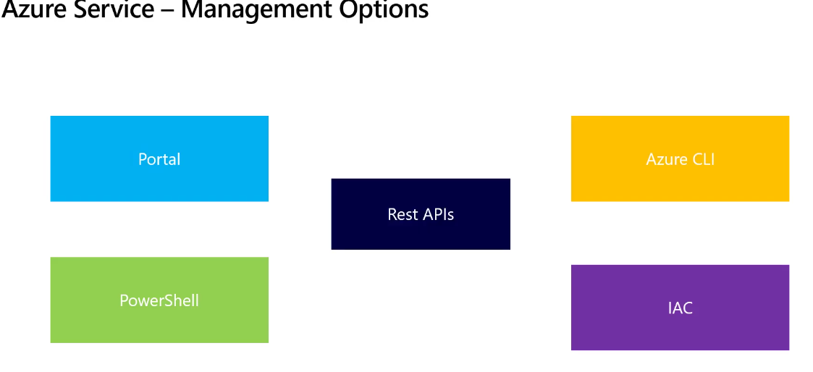
Common Way to Deploy Infa

Slide 4
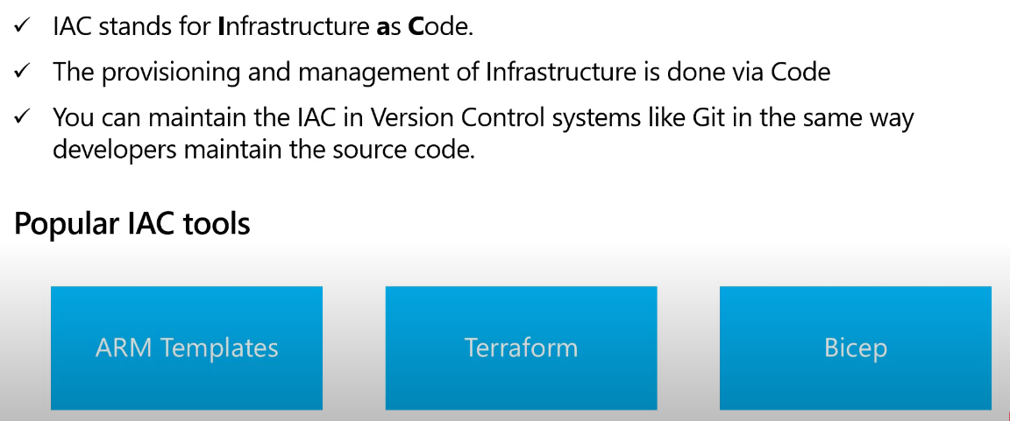
What is IAC

Slide 5
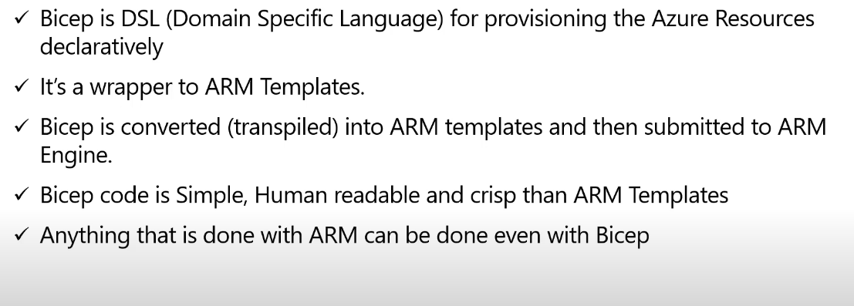
What Is Bicep

Slide 6
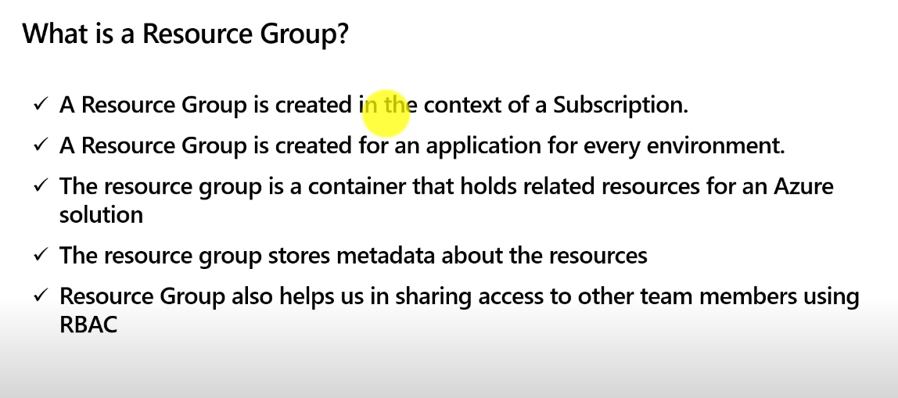
What Is Azure Resource Groupe

Slide 7
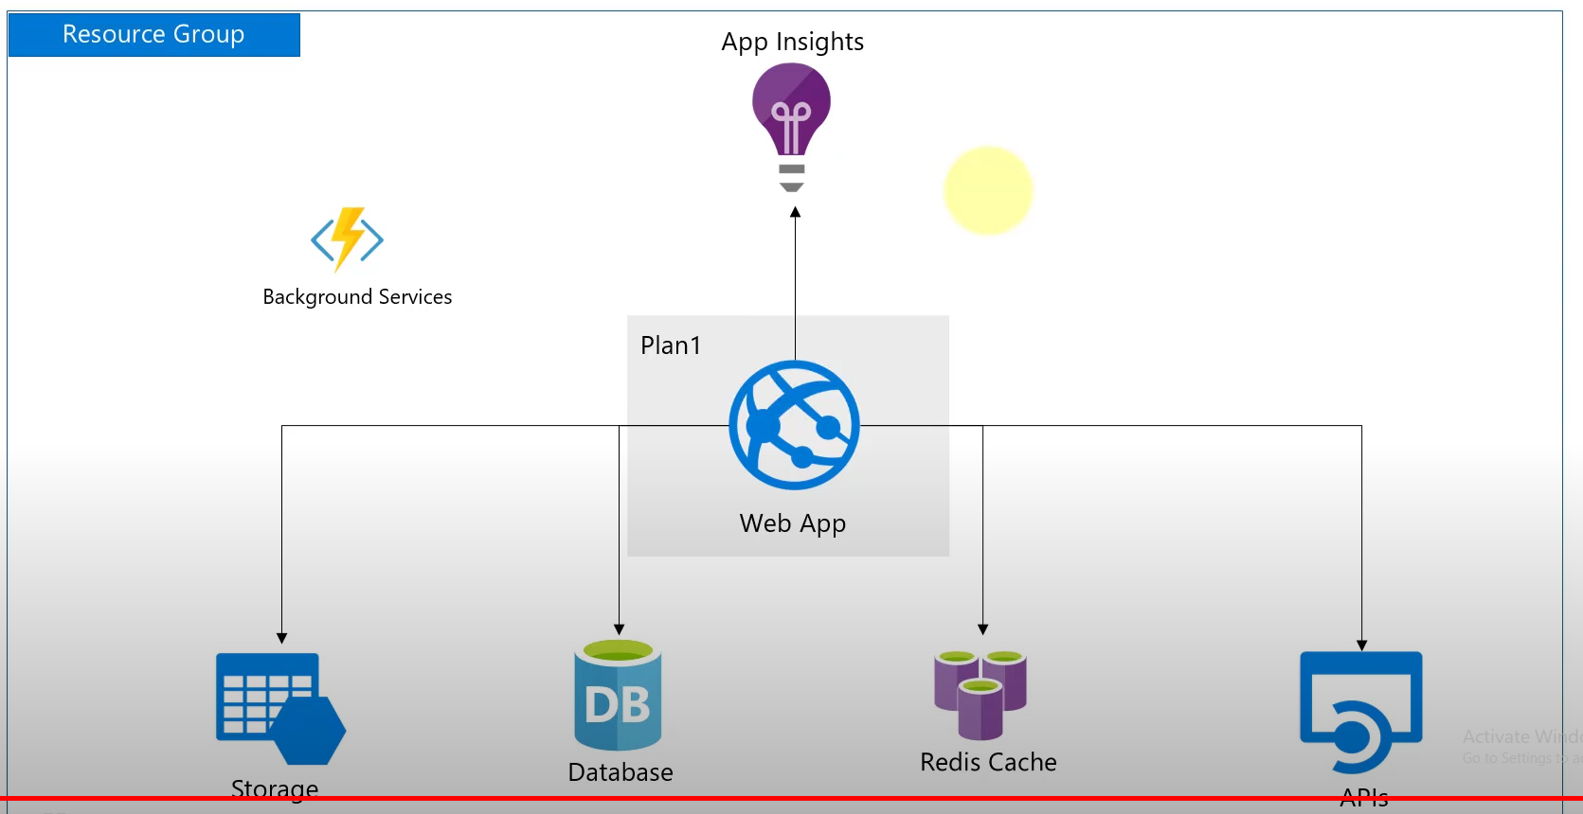
What Is Resource Groupe

Slide 8
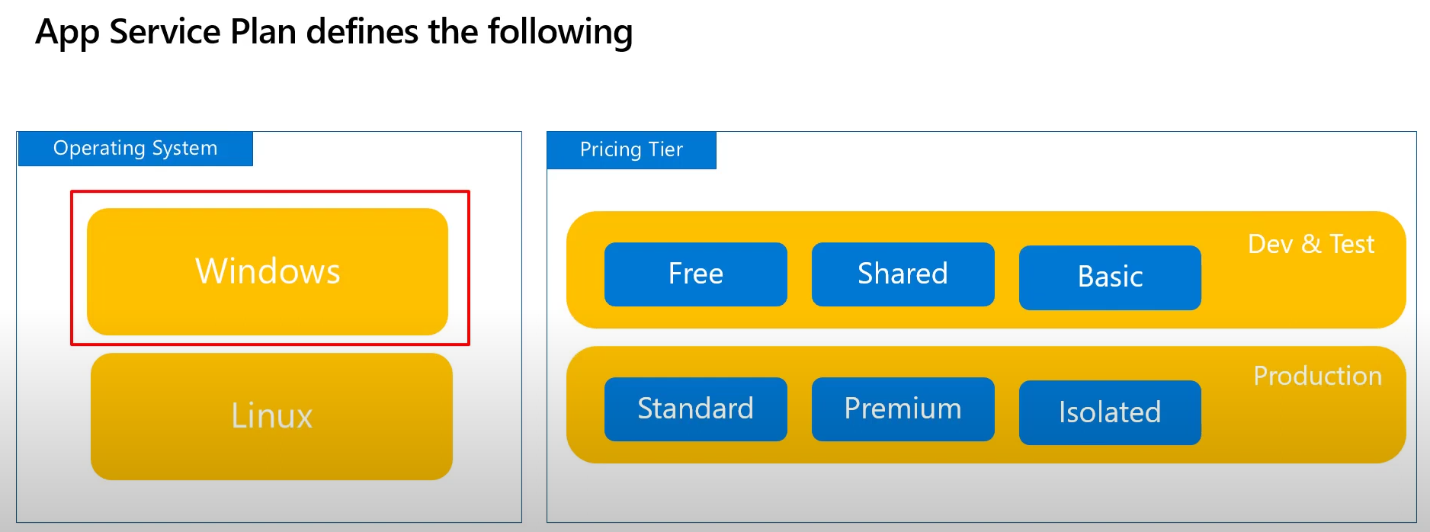
What Is App Service Plan
It’s required to run web application in a manage azure environment
resource appServicePlan 'Microsoft.Web/serverfarms@2020-12-01' = {
name: 'azr-asp-dev'
location: location
sku: {
name: 'S1'
capacity: 1
}
}
New-AzResourceGroupDeployment -ResourceGroupName 'azr_rs_group' -Name 'AppServicePlan' -Location 'East US' -TemplateFile .\AppServicePlan.bicep

Slide 9
What Is App Service Plan or Web/serverfarms
It’s required to run web application in a manage azure environment
var location = resourceGroup().location
resource appServicePlan 'Microsoft.Web/serverfarms@2020-12-01' = {
kind: 'linux' // if not specify default value is 'windows'
name: 'azr-asp-linux-dev'
location: location
sku: {
name: 'S1'
capacity: 1
}
// Property mandatory for linux deployment, could be remove if kind=windows
properties: {
reserved:true
}
}
Set-Location "C:\Users\Roodmack\Desktop\Azure Function\Bicep\05 Azure World Practice\2.App Service Plan"
New-AzResourceGroupDeployment -ResourceGroupName 'azr_rs_group' -Name 'AppServicePlan' -Mode "Incremental" -TemplateFile .\AppServicePlan.bicep

Slide 10

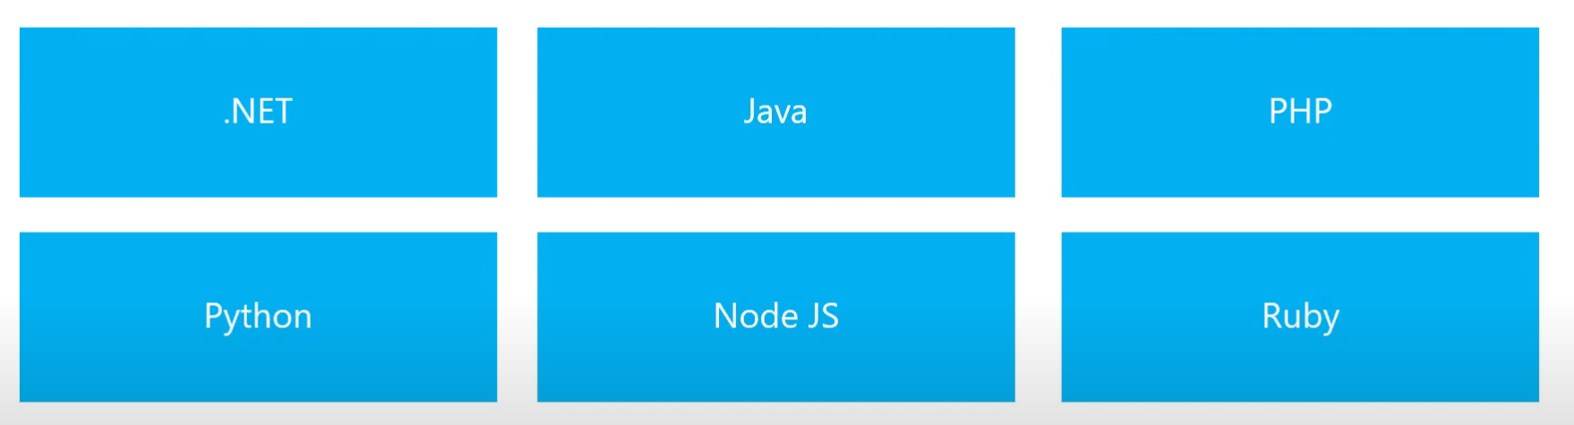

What Is an App Service or Web-App
Pass Service in Azure dedicate to Create Web Apps, Web API, Mobile Backends
var location = resourceGroup().location
// Create a windows App Service Plan or Serverfarm
resource AppServicePlan 'Microsoft.Web/serverfarms@2023-12-01'={
name: 'azr-aps-win-dev'
location: location
sku: {
name:'F1'
capacity: 1
}
}
// App Service or Web Application or Sites
resource webApplication 'Microsoft.Web/sites@2021-01-15' = {
name: 'azr-appservice-win-dev'
location: location
tags: {
'hidden-related:${resourceGroup().id}/providers/Microsoft.Web/serverfarms/appServicePlan': 'AppServicePlan'
}
properties: {
serverFarmId: AppServicePlan.id // id of the app service plan
}
}
Set-Location "C:\Users\Roodmack\Desktop\Azure Function\Bicep\05 Azure World Practice\3.App Service"
New-AzResourceGroupDeployment -ResourceGroupName 'azr_rs_group' -Name 'AppServicePlan' -Mode "Incremental" -TemplateFile .\AppService.bicep

Slide 11
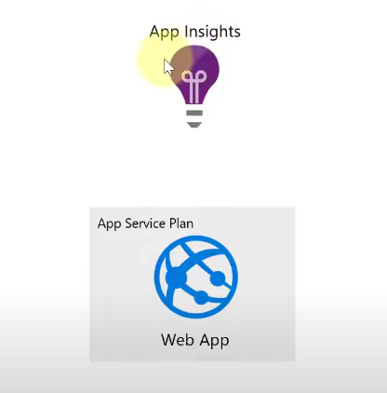

What Is Application Insight
var location = resourceGroup().location
resource appInsights 'Microsoft.Insights/components@2020-02-02' = {
name: 'azr-appinsight-dev'
location: location
kind: 'web'
properties: {
Application_Type: 'web'
}
dependsOn: [
webApplication
]
}
// Create App Setting for an Web App, those value will overight any thing from apps settings
resource appserviceappsetting 'Microsoft.Web/sites/config@2023-12-01'={
name: 'web'
parent: webApplication
properties: {
appSettings: [
{
name:'key1'
value: 'value1'
}
{
name: 'key2'
value: 'value22'
}
] } }
Azure service to retrieve application telemetry, or Log of another azure resource
App insight provide all the Built in report natively
Set-Location "C:\Users\Roodmack\Desktop\Azure Function\Bicep\05 Azure World Practice\4.Application Insight"
New-AzResourceGroupDeployment -ResourceGroupName 'azr_rs_group' -Name 'AppServicePlan' -Mode "Incremental" -TemplateFile .\AppInsight.bicep

Slide 12
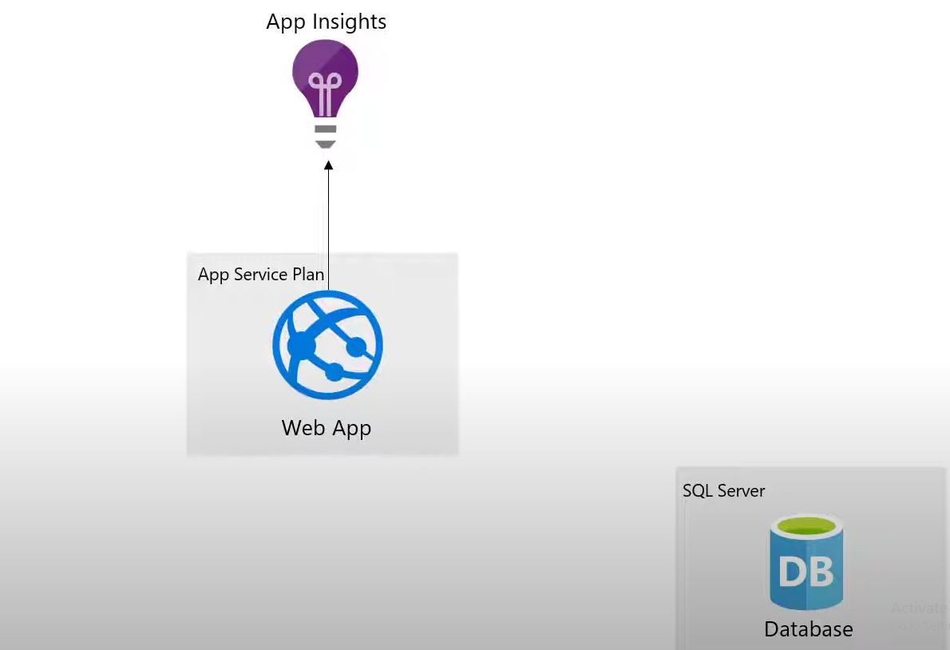
What Is Azure SQL Server Database
var location = resourceGroup().location // Create a SQL DataBase resource sqlServer 'Microsoft.Sql/servers@2014-04-01' ={
name: 'azr-sql-iac-dev'
location: location
properties: {
administratorLogin: 'roodmack'
administratorLoginPassword : 'PLRooimack789**'
} } // Witelisting IP Address for the SQL Servver , this is not overwrite the existing one
resource sqlServerFirewallRules 'Microsoft.Sql/servers/firewallRules@2021-02-01-preview' = {
parent: sqlServer
name: 'mypc ip Address'
properties: {
startIpAddress: '1.1.1.1'
endIpAddress: '1.1.1.1'
}
} // Create the Server
resource sqlServerDatabase 'Microsoft.Sql/servers/databases@2021-11-01'={
parent: sqlServer
name: 'db1'
location: location
properties: {
collation: 'SQL_Latin1_General_CP1_CI_AS'
maxSizeBytes: 2147483648 // Example value: 2 GB
} }
Set-Location "C:\Users\Roodmack\Desktop\Azure Function\Bicep\05 Azure World Practice\5.Azure SQL Database"
New-AzResourceGroupDeployment -ResourceGroupName 'azr_rs_group' -Name 'AppServicePlan' -Mode "Incremental" -TemplateFile .\SQLDatabase.bicep

Slide 13
What Is App Service Plan
It’s required to run web application in a manage azure environment
var location = resourceGroup().location
resource appServicePlan 'Microsoft.Web/serverfarms@2020-12-01' = {
kind: 'linux' // if not specify default value is 'windows'
name: 'azr-asp-linux-dev'
location: location
sku: {
name: 'S1'
capacity: 1
}
// Property mandatory for linux deployment, could be remove if kind=windows
properties: {
reserved:true
}
}
Set-Location "C:\Users\Roodmack\Desktop\Azure Function\Bicep\05 Azure World Practice\2.App Service Plan"
New-AzResourceGroupDeployment -ResourceGroupName 'azr_rs_group' -Name 'AppServicePlan' -Mode "Incremental" -TemplateFile .\AppServicePlan.bicep

Slide 14
What Is App Service Plan
It’s required to run web application in a manage azure environment
var location = resourceGroup().location
resource appServicePlan 'Microsoft.Web/serverfarms@2020-12-01' = {
kind: 'linux' // if not specify default value is 'windows'
name: 'azr-asp-linux-dev'
location: location
sku: {
name: 'S1'
capacity: 1
}
// Property mandatory for linux deployment, could be remove if kind=windows
properties: {
reserved:true
}
}
Set-Location "C:\Users\Roodmack\Desktop\Azure Function\Bicep\05 Azure World Practice\2.App Service Plan"
New-AzResourceGroupDeployment -ResourceGroupName 'azr_rs_group' -Name 'AppServicePlan' -Mode "Incremental" -TemplateFile .\AppServicePlan.bicep

Slide 15
What Is App Service Plan
It’s required to run web application in a manage azure environment
var location = resourceGroup().location
resource appServicePlan 'Microsoft.Web/serverfarms@2020-12-01' = {
kind: 'linux' // if not specify default value is 'windows'
name: 'azr-asp-linux-dev'
location: location
sku: {
name: 'S1'
capacity: 1
}
// Property mandatory for linux deployment, could be remove if kind=windows
properties: {
reserved:true
}
}
Set-Location "C:\Users\Roodmack\Desktop\Azure Function\Bicep\05 Azure World Practice\2.App Service Plan"
New-AzResourceGroupDeployment -ResourceGroupName 'azr_rs_group' -Name 'AppServicePlan' -Mode "Incremental" -TemplateFile .\AppServicePlan.bicep

Slide 16
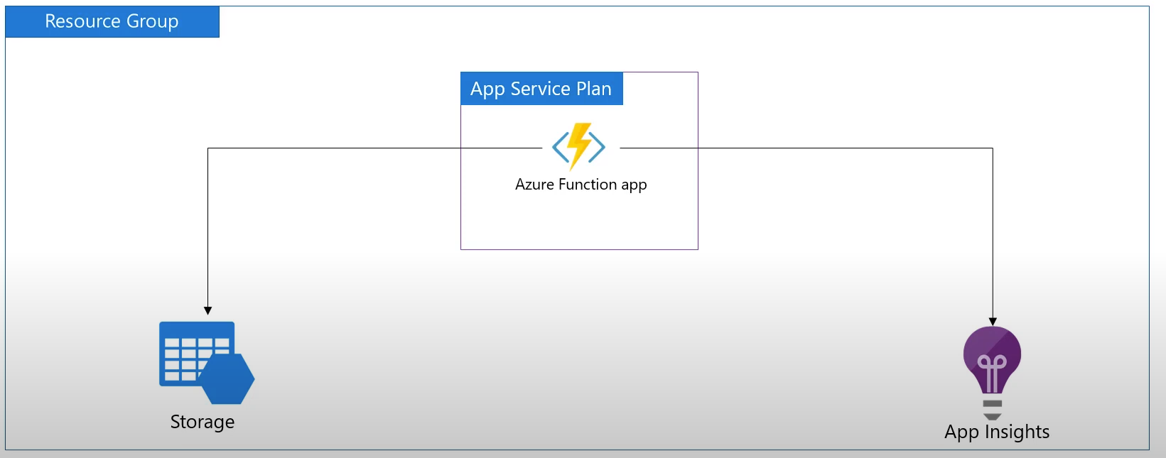
What Is Azure Serverless Function
Allow to run Code on cloud without any on prem server infra, Microsoft handle all the Service
param pAzureFunctionName string
param location string
param pAppServicePlanID string
// param pstorageAccountKey array // list of storage account key
param pAppInsightsKey string
param pstorageaccountName string
param pstorageaccountID string
resource azureFunction 'Microsoft.Web/sites@2020-12-01' = {
name: pAzureFunctionName
location: location
kind: 'functionapp'
identity: {
type:'SystemAssigned'
}
tags: {
func: 'Func Bicep'
}
properties: {
serverFarmId: pAppServicePlanID
siteConfig: {
appSettings: [
{
name: 'AzureWebJobsDashboard'
value: 'DefaultEndpointsProtocol=https;AccountName=${pstorageaccountName};AccountKey=${listKeys(pstorageaccountID, '2021-09-01').keys[0].value}'
}
{
name: 'AzureWebJobsStorage'
value: 'DefaultEndpointsProtocol=https;AccountName=${pstorageaccountName};AccountKey=${listKeys(pstorageaccountID, '2021-09-01').keys[0].value}'
}
{
name: 'WEBSITE_CONTENTAZUREFILECONNECTIONSTRING'
value: 'DefaultEndpointsProtocol=https;AccountName=${pstorageaccountName};AccountKey=${listKeys(pstorageaccountID, '2021-09-01' ).keys[0].value}' // '2019-06-01'
}
{
name: 'WEBSITE_CONTENTSHARE'
value: toLower(pAzureFunctionName)
}
{
name: 'FUNCTIONS_EXTENSION_VERSION'
value: '~4'
}
{
name: 'APPINSIGHTS_INSTRUMENTATIONKEY'
value: pAppInsightsKey//reference(pAppInsightsID, '2015-05-01').InstrumentationKey
}
{
name: 'FUNCTIONS_WORKER_RUNTIME'
value: 'powershell'
}
]
}
}
}
Function App is Part of the App Service Plan, and Azure Function require a storage Account, App Insight is not Mandatory

Slide 17
What Is Resource Groupe

Slide 20
Bicep Tips

Slide 21
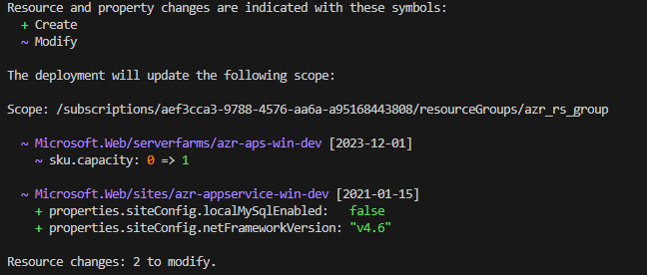
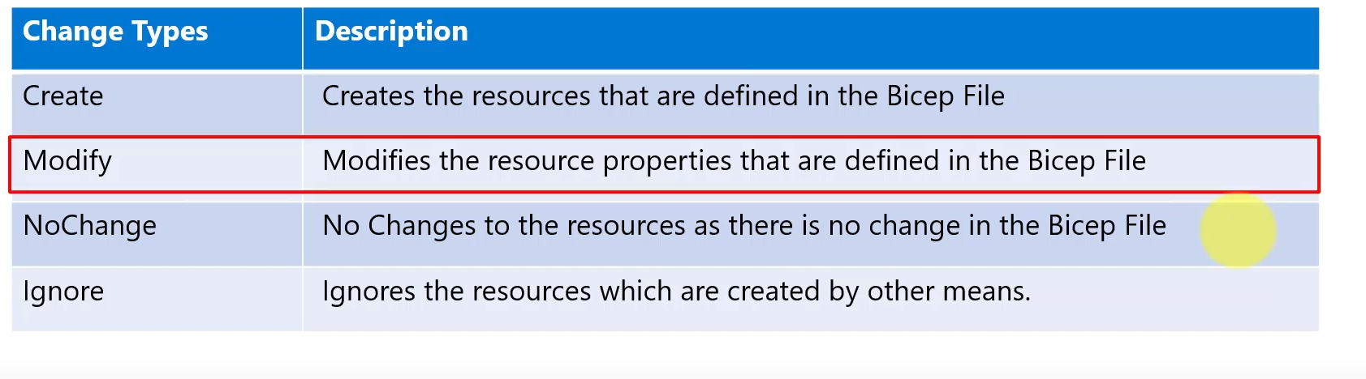
Preview Resource before creation with –What-if

Slide 22
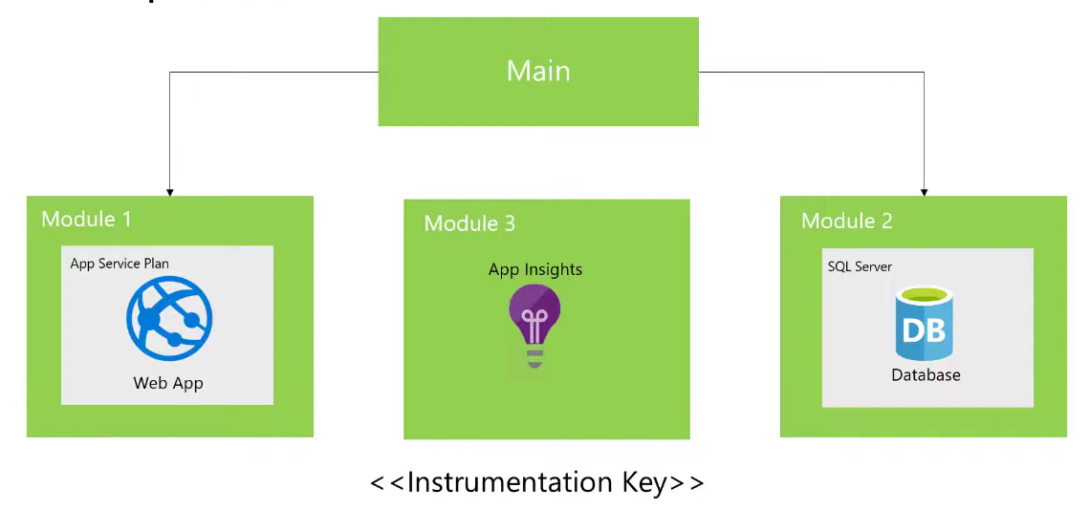
Module Bicep

Slide 23
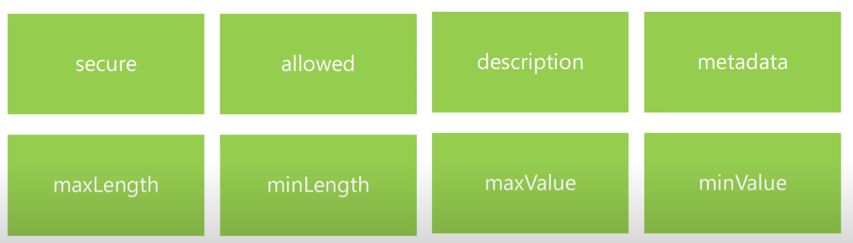
Azure Bicep Decorators
Decorator allow you to control parameter value , like restricted list, add description, and secure string for password

Slide 24
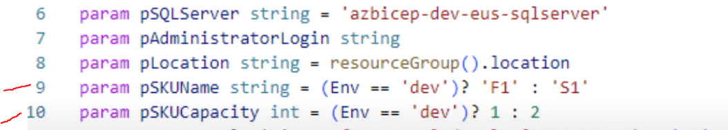
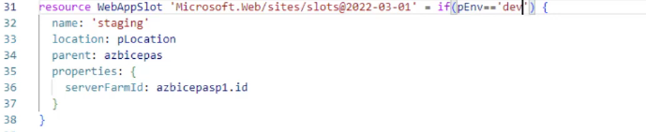
Azure Bicep Condition Expression / Deployment
Decorator allow you to control parameter value , like restricted list, add description, and secure string for password
Condition expression on Parameter:
Condition expression resource Deployment:

Slide 25
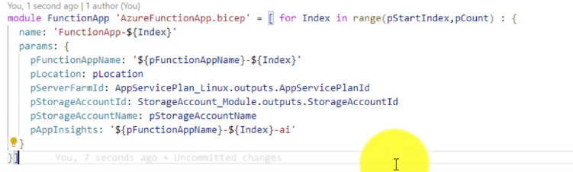
Azure Bicep Loop
Iterate through range or array to create multiple resource
Resource resourrcename apiversion = [for i in Array : {
Resource here
}]
Syntax :

Slide 26
Role Assignement
https://learn.microsoft.com/en-us/azure/role-based-access-control/built-in-roles
https://learn.microsoft.com/en-us/azure/role-based-access-control/role-assignments-template
Built-in role | Description | ID
Contributor | Grants full access to manage all resources, but does not allow you to assign roles in Azure RBAC, manage assignments in Azure Blueprints, or share image galleries. | b24988ac-6180-42a0-ab88-20f7382dd24c
Owner | Grants full access to manage all resources, including the ability to assign roles in Azure RBAC. | 8e3af657-a8ff-443c-a75c-2fe8c4bcb635
Reservations Administrator | Lets one read and manage all the reservations in a tenant | a8889054-8d42-49c9-bc1c-52486c10e7cd
Role Based Access Control Administrator | Manage access to Azure resources by assigning roles using Azure RBAC. This role does not allow you to manage access using other ways, such as Azure Policy. | f58310d9-a9f6-439a-9e8d-f62e7b41a168
User Access Administrator | Lets you manage user access to Azure resources. | 18d7d88d-d35e-4fb5-a5c3-7773c20a72d9
Reader | View all resources, but does not allow you to make any changes. | acdd72a7-3385-48ef-bd42-f606fba81ae7
// Assign SPN azr_purview_restapi : https://learn.microsoft.com/en-us/azure/role-based-access-control/built-in-roles
resource rbacSpn 'Microsoft.Authorization/roleAssignments@2022-04-01'= {
name:guid(keyVault.id, 'SecretOfficer', spid) // Unique role assignment name
scope: keyVault
properties: {
principalId: spid
roleDefinitionId: subscriptionResourceId('Microsoft.Authorization/roleDefinitions', 'b86a8fe4-44ce-4948-aee5-eccb2c155cd7') // Assign key vault Officer Role base on this id : 'b86a8fe4-44ce-4948-aee5-eccb2c155cd7'
principalType: 'ServicePrincipal'
description: 'AZR Power BI SPN Connection'
}
}

Slide 27

Azure Container Registry
Unified Azure Bicep Module Deployment by Leverage Azure Container Registry

Slide 28
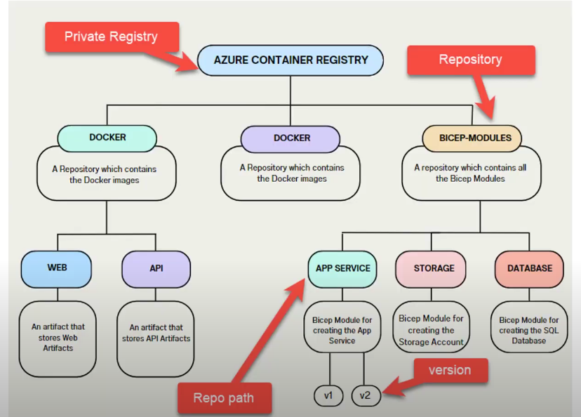
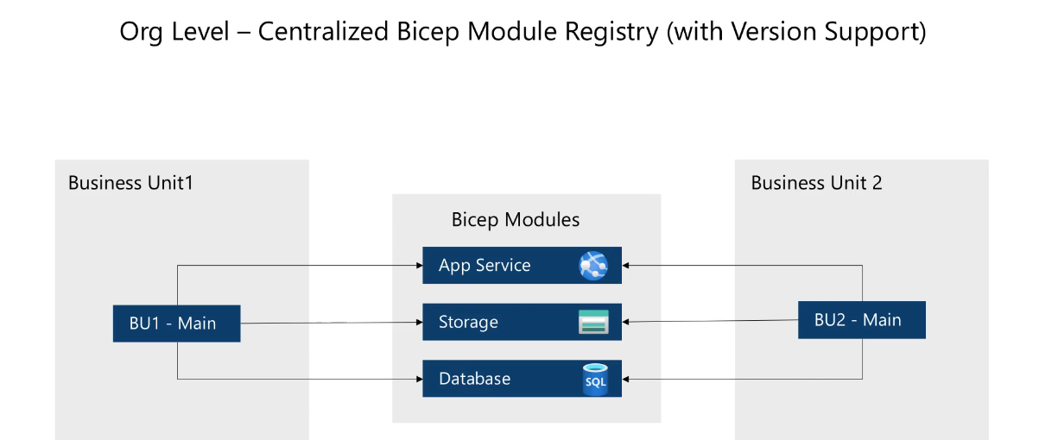
Azure Bicep Organization

Slide 29
Azure Bicep Condition Expression
Decorator allow you to control parameter value , like restricted list, add description, and secure string for password
Syntax :

Slide 34
Azure Data Factory
LV
Lerevit
Complete Guideline

